Slide 4
What is Spring Boot ?
Spring Boot is the combination of Spring Framework and Embedded Servers.
In Spring Boot, there is no requirement for XML configuration (deployment descriptor). It uses convention over configuration software design paradigm that means it decreases the effort of the developer.

Slide 5
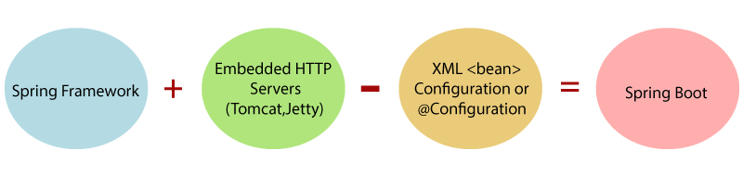
What is Spring Boot ?

Slide 6
The main goal of Spring Boot Framework is to reduce Development, Unit Test and Integration Test time and to ease the development of Production ready web applications very easily compared to existing Spring Framework, which really takes more time.
To avoid XML Configuration completely
To avoid defining more Annotation Configuration(It combined some existing Spring Framework Annotations to a simple and single Annotation)
To avoid writing lots of import statements
To provide some defaults to quick start new projects within no time.
To provide Opinionated Development approach.
By providing or avoiding these things, Spring Boot Framework reduces Development time, Developer Effort and increases productivity.

Slide 7
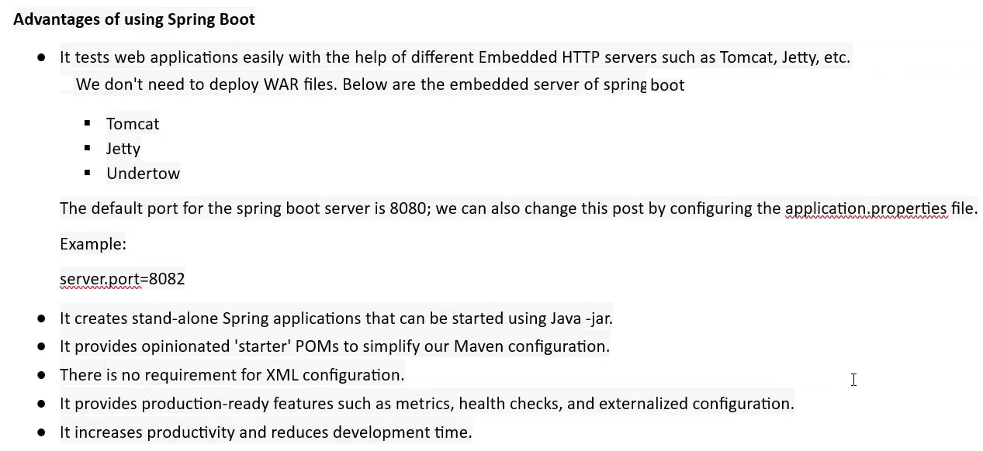

Slide 8
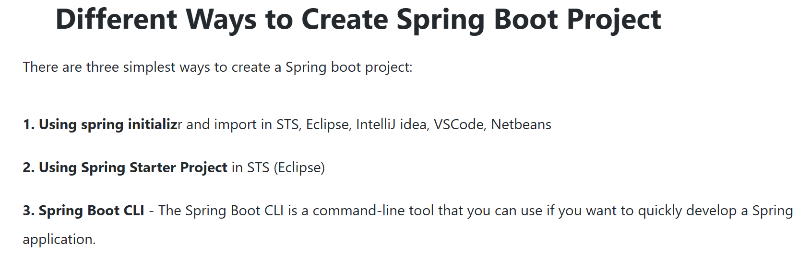

Slide 9
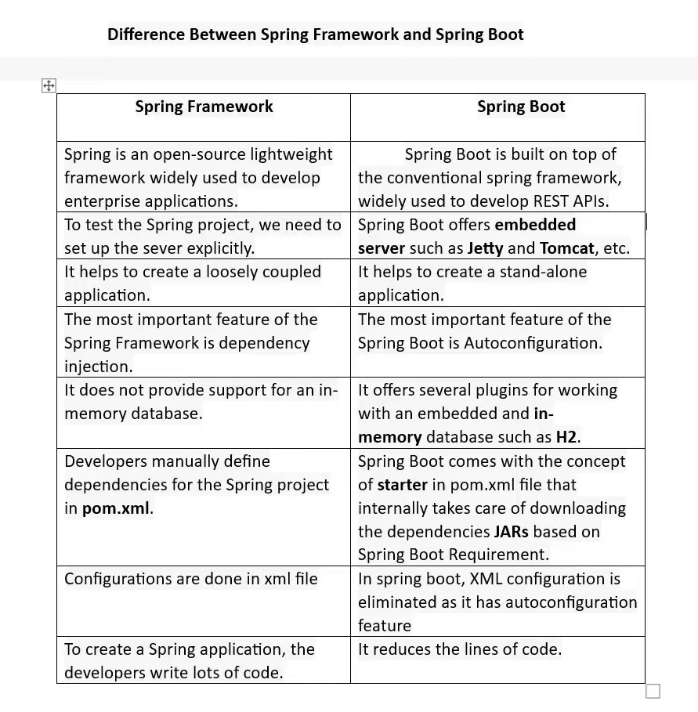

Slide 10
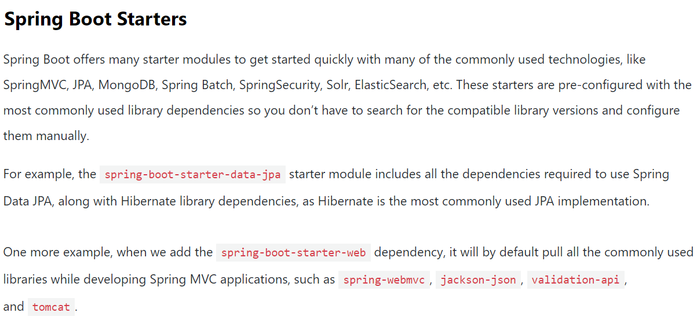

Slide 11
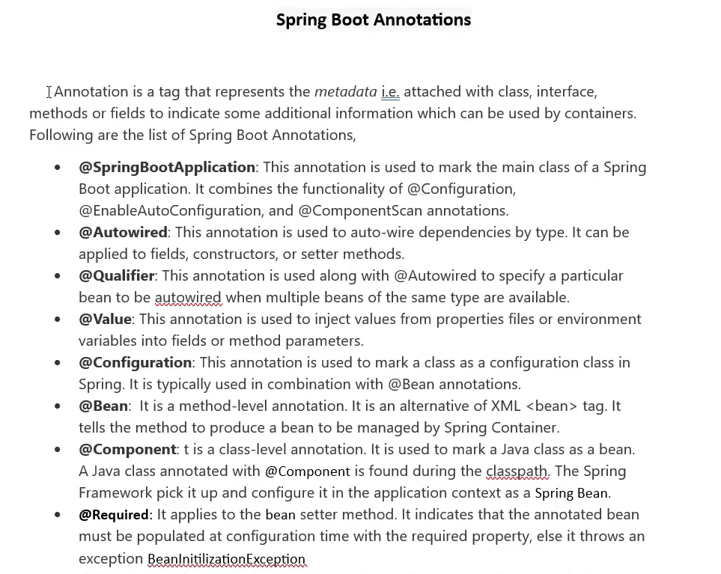

Slide 12
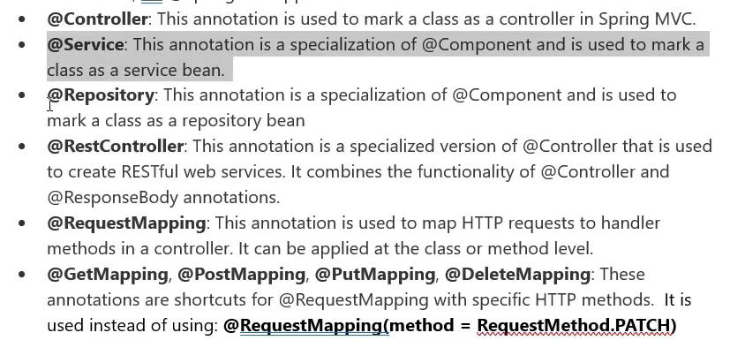

Slide 13
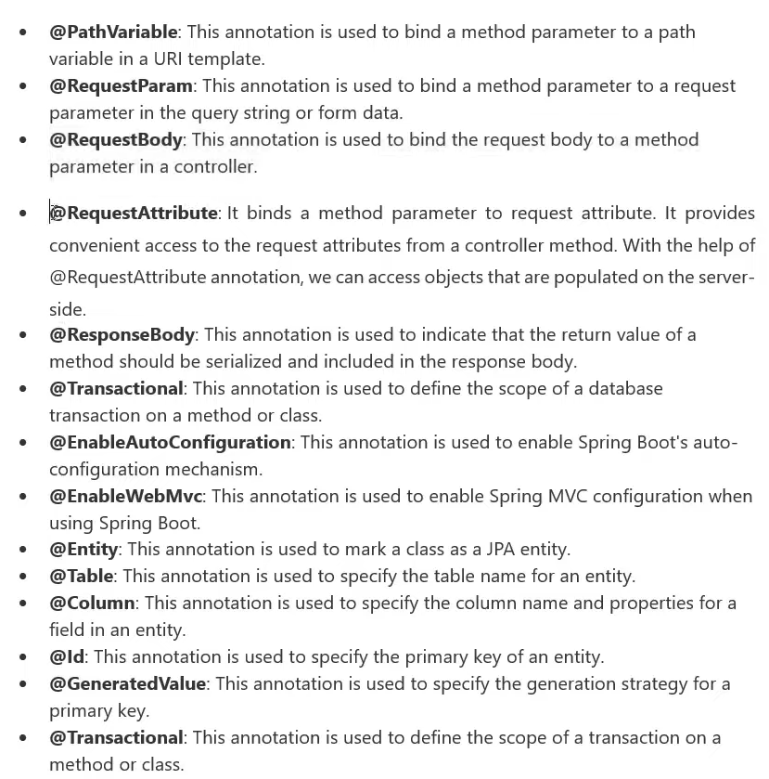

Slide 14
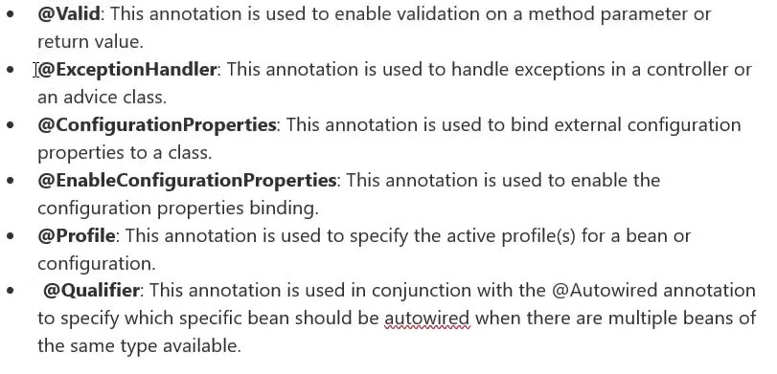

Slide 15
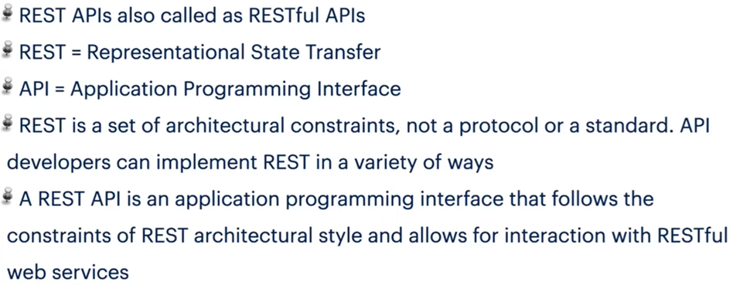

Slide 16
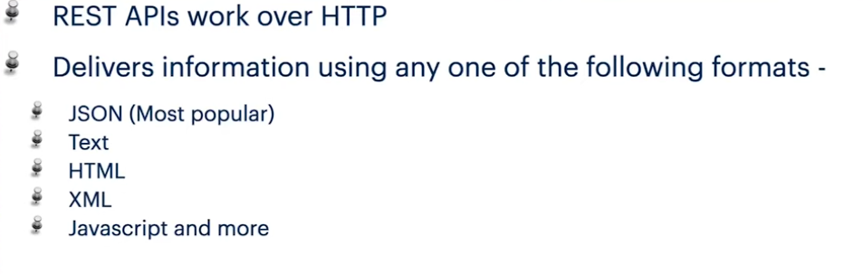

Slide 17
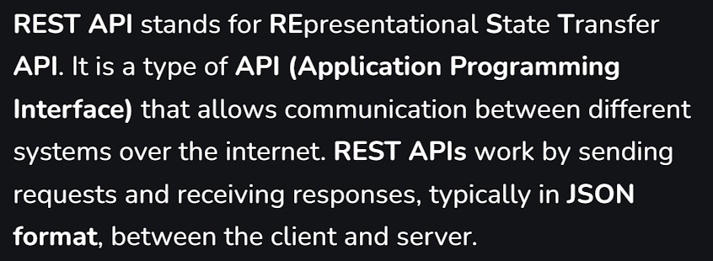

Slide 18
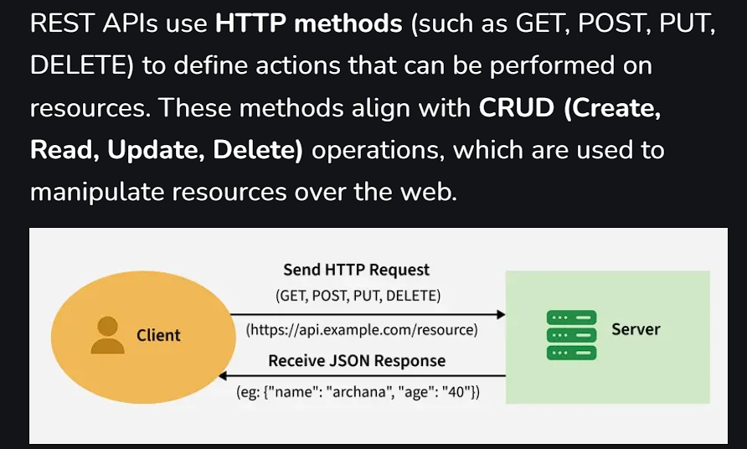

Slide 19
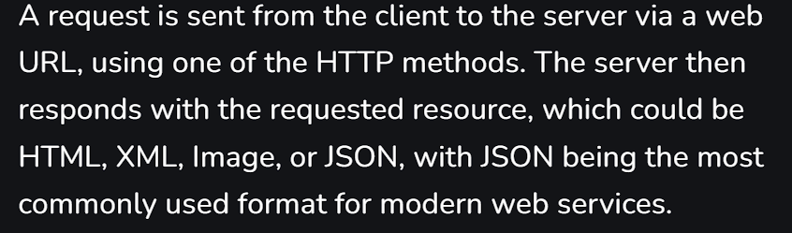

Slide 20
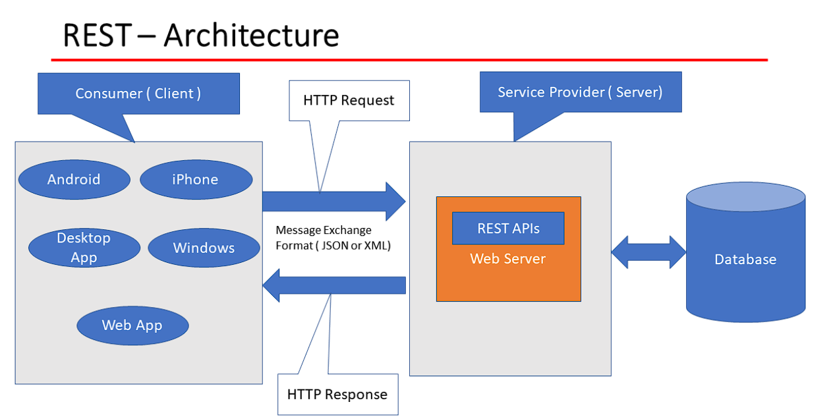

Slide 21
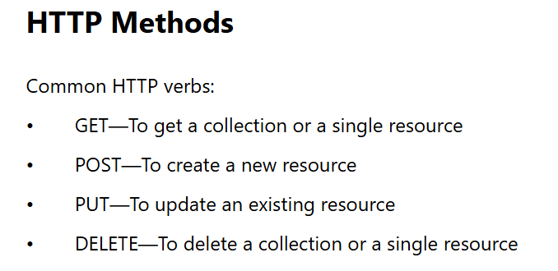

Slide 22
